Slide 1
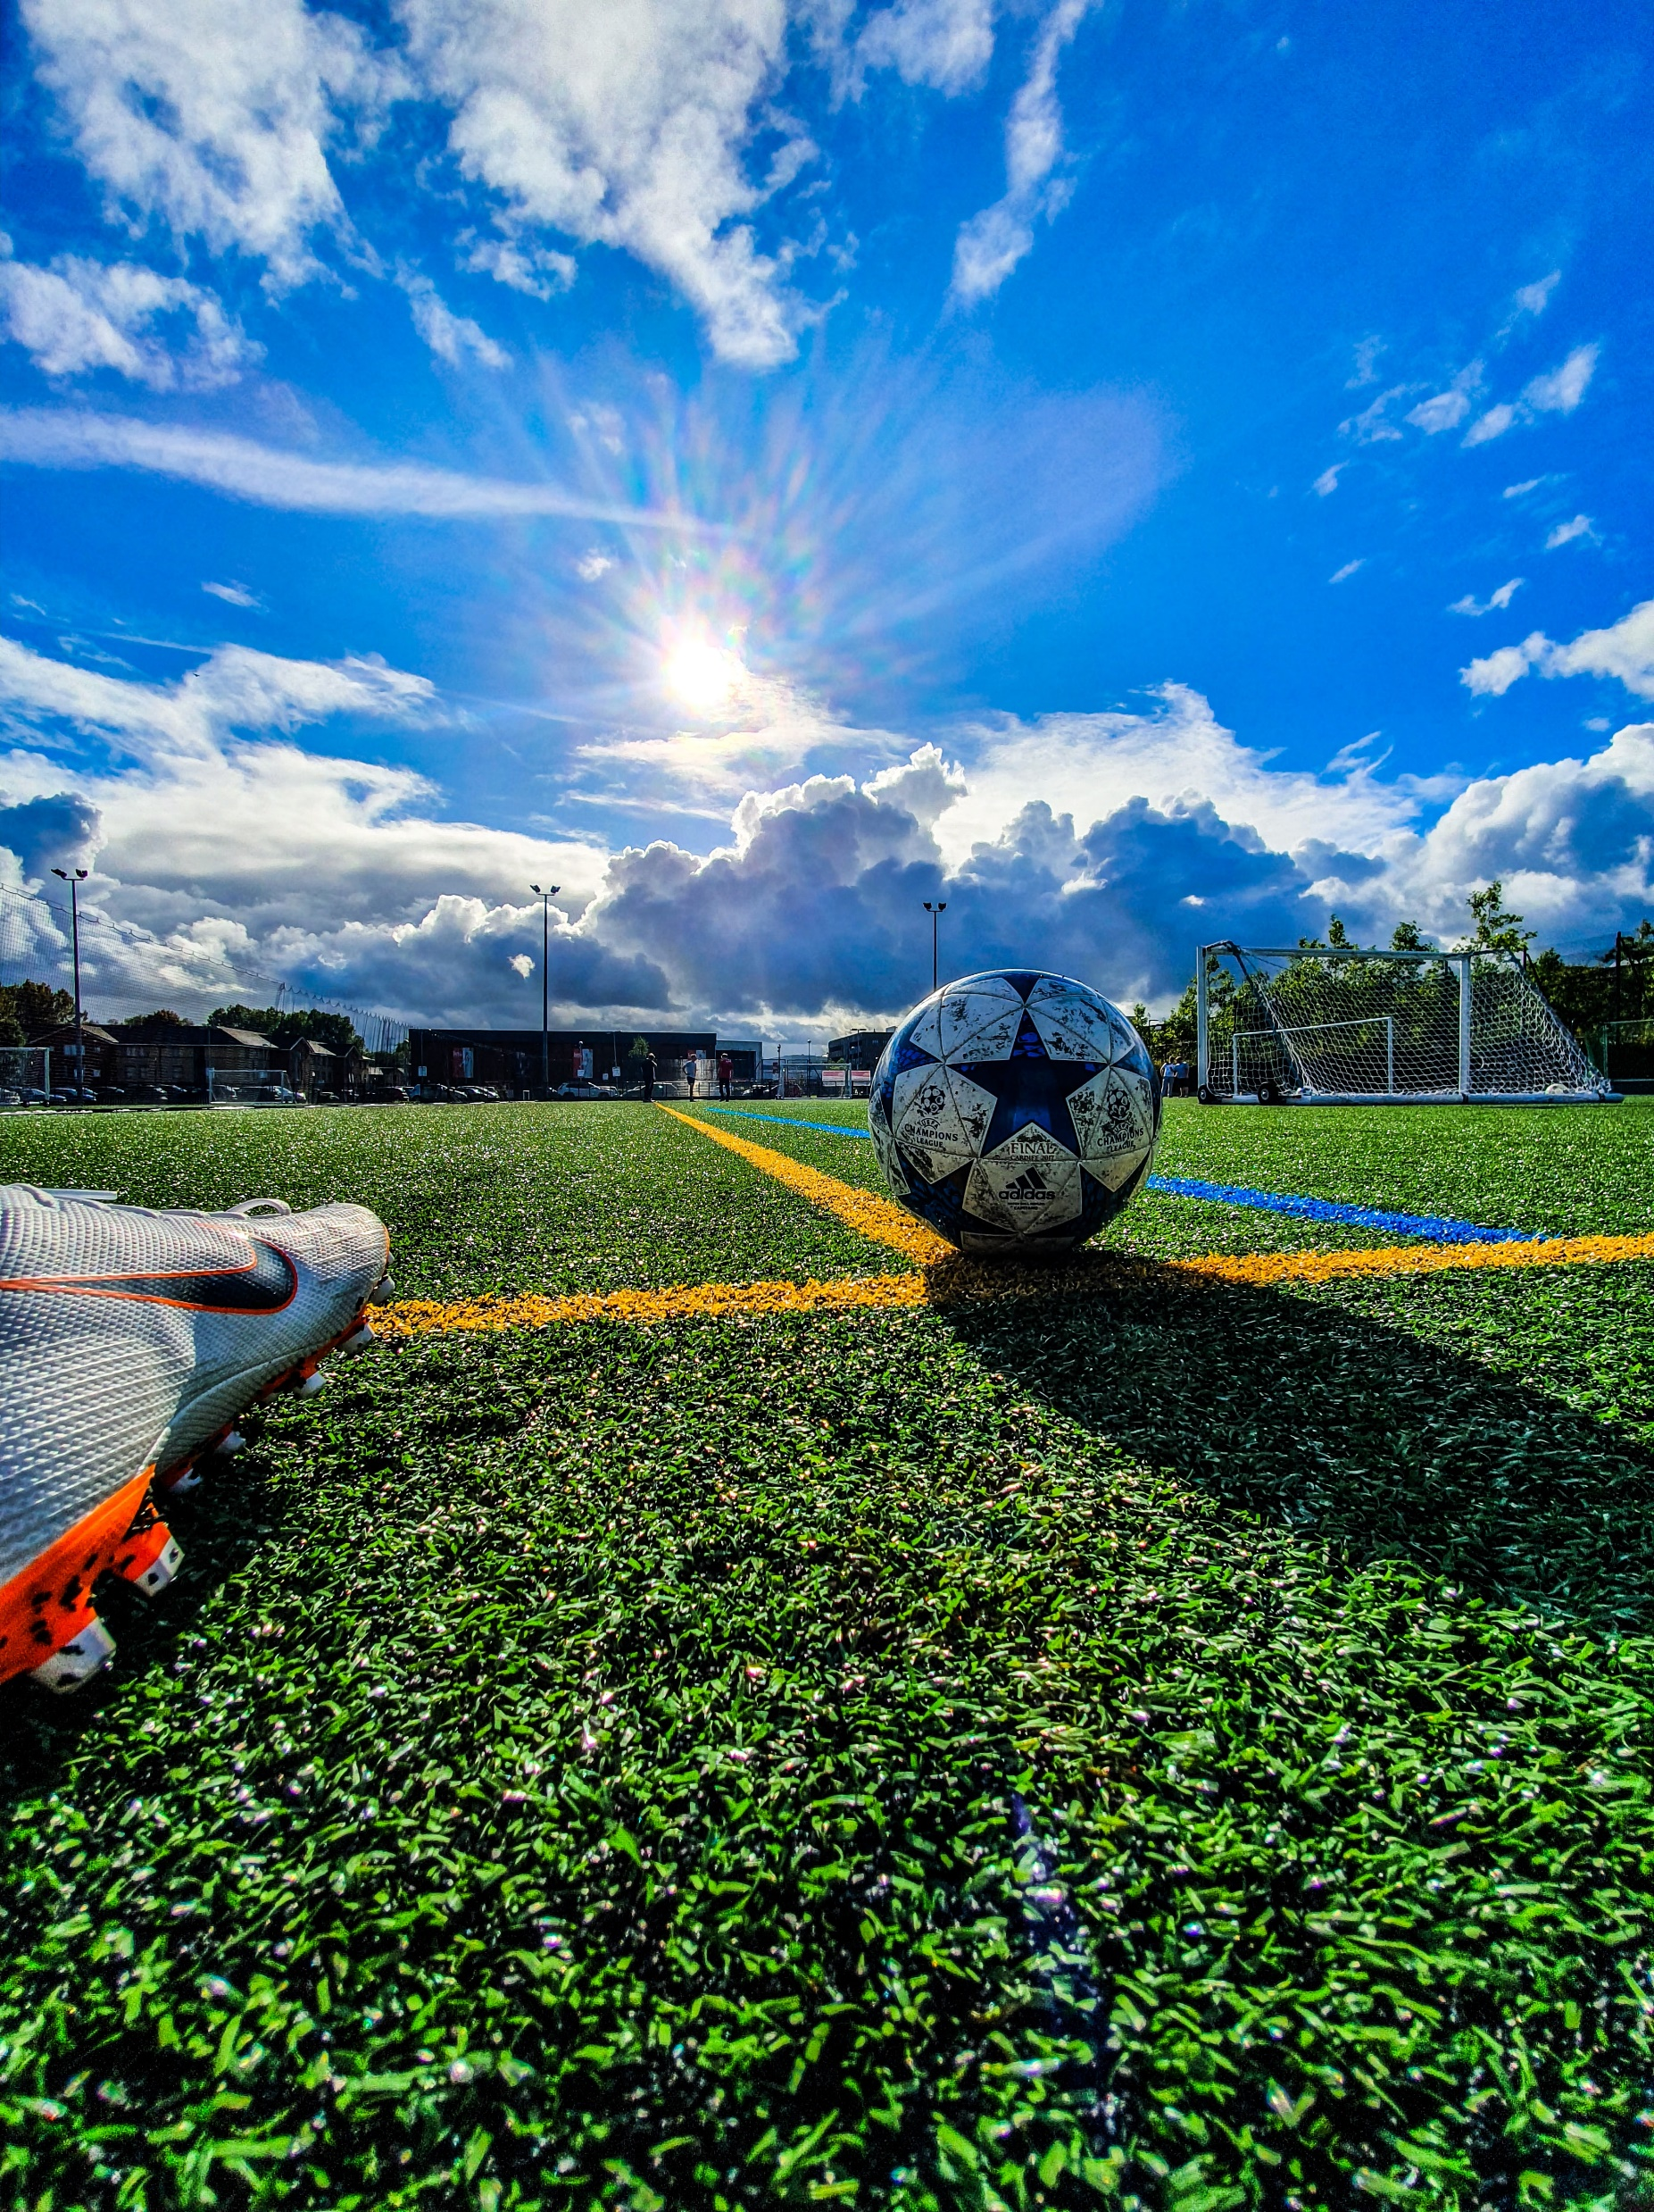
Picnic game
Project by SKA team

Slide 2
Introduction
Requirements specification
Problem Statement

Slide 3
INTRODUCTI0N
The thirst for learning, upgrading technical skills and applying the concepts in real life environment at a fast pace is what the industry demands from IT professionals today. However busy work schedules, far-flung locations, unavailability of convenient time-slots pose as major barriers when it comes to applying the concepts into realism. And hence the need to look out for alternative means of implementation in the form of laddered approach.
The above truly pose as constraints especially for our students too! With their busy schedules, it is indeed difficult for our students to keep up with the genuine and constant need for integrated application which can be seen live especially so in the field of IT education where technology can change on the spur of a moment. Well, technology does come to our rescue at such times!!
Keeping the above in mind and in tune with our constant endeavour to use Technology in our training model, we at Aptech have thought of revolutionizing the way our students learn and implement the concepts using tools themselves by providing a live and synchronous eProject learning environment!

Slide 4
Requirements
The Home Page should be created making use of Sections with a suitable logo, the header section can be added which will show images of various creative products.
The site must contain the links to navigate through any category for the information.
The games should be categorized according to the type of games indoor/outdoor
Also there should different be sections for
Kids
Males
Females
Family games
When a user selects any particular category, a list of available game options for that particular category will be displayed
All details about the selected game to be displayed as material needed, time required, how to play etc with the demo videos / instruction document ,also these should be stored in Individual Word documents which can be downloaded or viewed by the User who wishes to see the same.
Along with the games there should also be a section for a common iternery for small getaways with suggested locations.
Site Makers Contact us page: contact us details with location should be displayed using GeoLocation API (eg. GoogleMaps).
Navigation should be smooth and images should be clear.

Slide 5
Problem Statement
In today’s busy and active world, quality time with family, friends and relatives is often overlooked, but picnics can be helpful in making up for some of this lost time.
Spending time together benefits children by providing security, love, and a sense of belonging. Taking time to talk with your children is a great way to connect with them and learn from each other. Regular communication can also give family members chances to plan other fun and engaging activities.
Fun games and little competitions are great ways to keep children occupied while engaging with the family.
Hence it is thought of developing a website which will provide variety of indoor/outdoor picnic games that can be enjoyed with all.

